Slide 1


Case Study: Predicting Patient Readmission
September 5th, 2018
Notes:
A problem statement.
Metrics and assumptions.
Approach and process.
Your model or solution.
Performance evaluation (how your approach compares to your original success metrics).
Impact of your findings.
Recommendations or next steps.

Slide 2

Table of Contents
Problem Statement
Metrics and Assumptions
Approach and Process
Model
Retrospective

Slide 3










Problem Statement
Chronic disease readmission is one of the leading cost drivers in US healthcare
By the Numbers
Key Challenges
Top Readmission Cases
2017 Readmission Cost: $310M across top 10 heath systems
Readmission penalties
Schizophrenia
Expensive specialty treatments
Diabetes
Growth: 9.5-15% Expected CAGR from 2017-2022
Resource allocation
challenges
Surgical complications
In this study, we analyzed a patient dataset from 2001-2011 that contains demographic and treatment information for 100,000 diabetes cases, and built a classification model to predict whether or not a given patient would be readmitted within 30 days of discharge

Slide 4

Problem Statement (Cont.)
Identifying high-risk readmission cases is key to reducing mortality rates related to chronic health complications

Slide 5








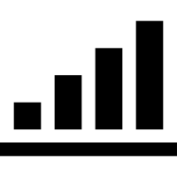
Dataset, Assumptions, and Metrics
Dataset
Assumptions
Data was pulled from the UCLA medical learning library
Results from the dataset should only be generalized for patients with diabetes
Assumed data was accurate for a given patient
101,776 Rows x 50 Columns
Messy: Contained missing values, string and number pairs, ambiguous features
Assumed that dataset was pulled from a random sample of diabetes patients
Key Metrics
Model was evaluated against a null model that predicted that the patient would not be readmitted for all cases, because that is currently the industry standard.
Goal: Outperform null model

Slide 6
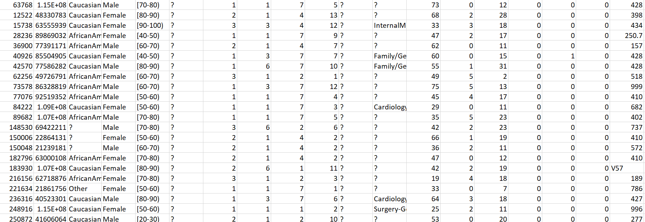
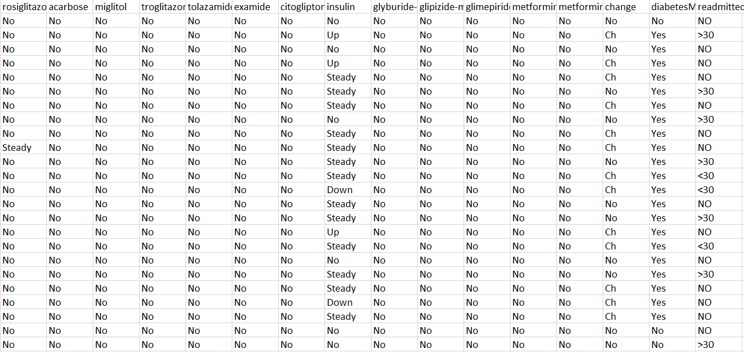
Data
Notes:
Insurance companies
SOS doctors
Docsvisit

Slide 7


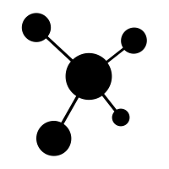







Approach
Identify Problem
Pull explore data
Model and Predict
Measure Performance and Report
Identified patient readmission as the problem to address and looked for relevant data sources
Pulled, cleaned, and dropped data as necessary
Trained decision tree, random forest, and boosted models
Re-engineered data as necessary
Measured tree accuracy and reported
Train-Test-Split
Train Decision Tree
Train Random Forest
Train Ada Boost
Apply Feature Selection
Apply Feature Selection
Apply Feature Selection
Notes:
Numerous unexpected blockers
Missed deadlines early on
Lower team morale
Back-to-back-to-back meetings
Conflicting priorities among leaders
Constantly changing requirements
System integration challenges
“Waiting for approval” downtime
Death by status report

Slide 8
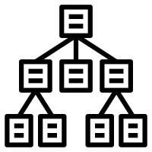

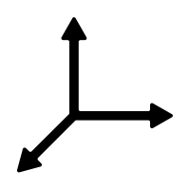




Model and Solution
Three classification models were trained using the patient dataset, and measured against a null model performance
Decision Tree
Random Forest Classifier
Ada Boost Classifier
No max depth
100 decision trees
100 decision trees
No min-leaf size
No max depth
0.1 learning rate
SelectFromModel feature-selector was applied to isolate important features
SelectFromModel feature-selector was applied to isolate important features
SelectFromModel feature-selector was applied to isolate important features
Accuracy: 47.1%
Accuracy: 57.6%
Accuracy: 59.1%
Null Model Performance: 51%

Slide 9
Retrospective
Spend more time up-front cleaning data
Features and rows were dropped due to missing data or lack of interpretability, which reduced robustness of the model
More effort in cleaning features would have increased accuracy
Train models with small n_estimators at first
Due to high number of features, Random Forest and Ada boost classifiers took a longtime to run (~25-40 minutes) and yielded marginal improvements run-over-run
Incorporate more robust classifiers into ensemble
Outside of Adaboost, I would have liked to implement XG Boost and potentially a deep learning classifier

Slide 10

Questions?

